Slide 1

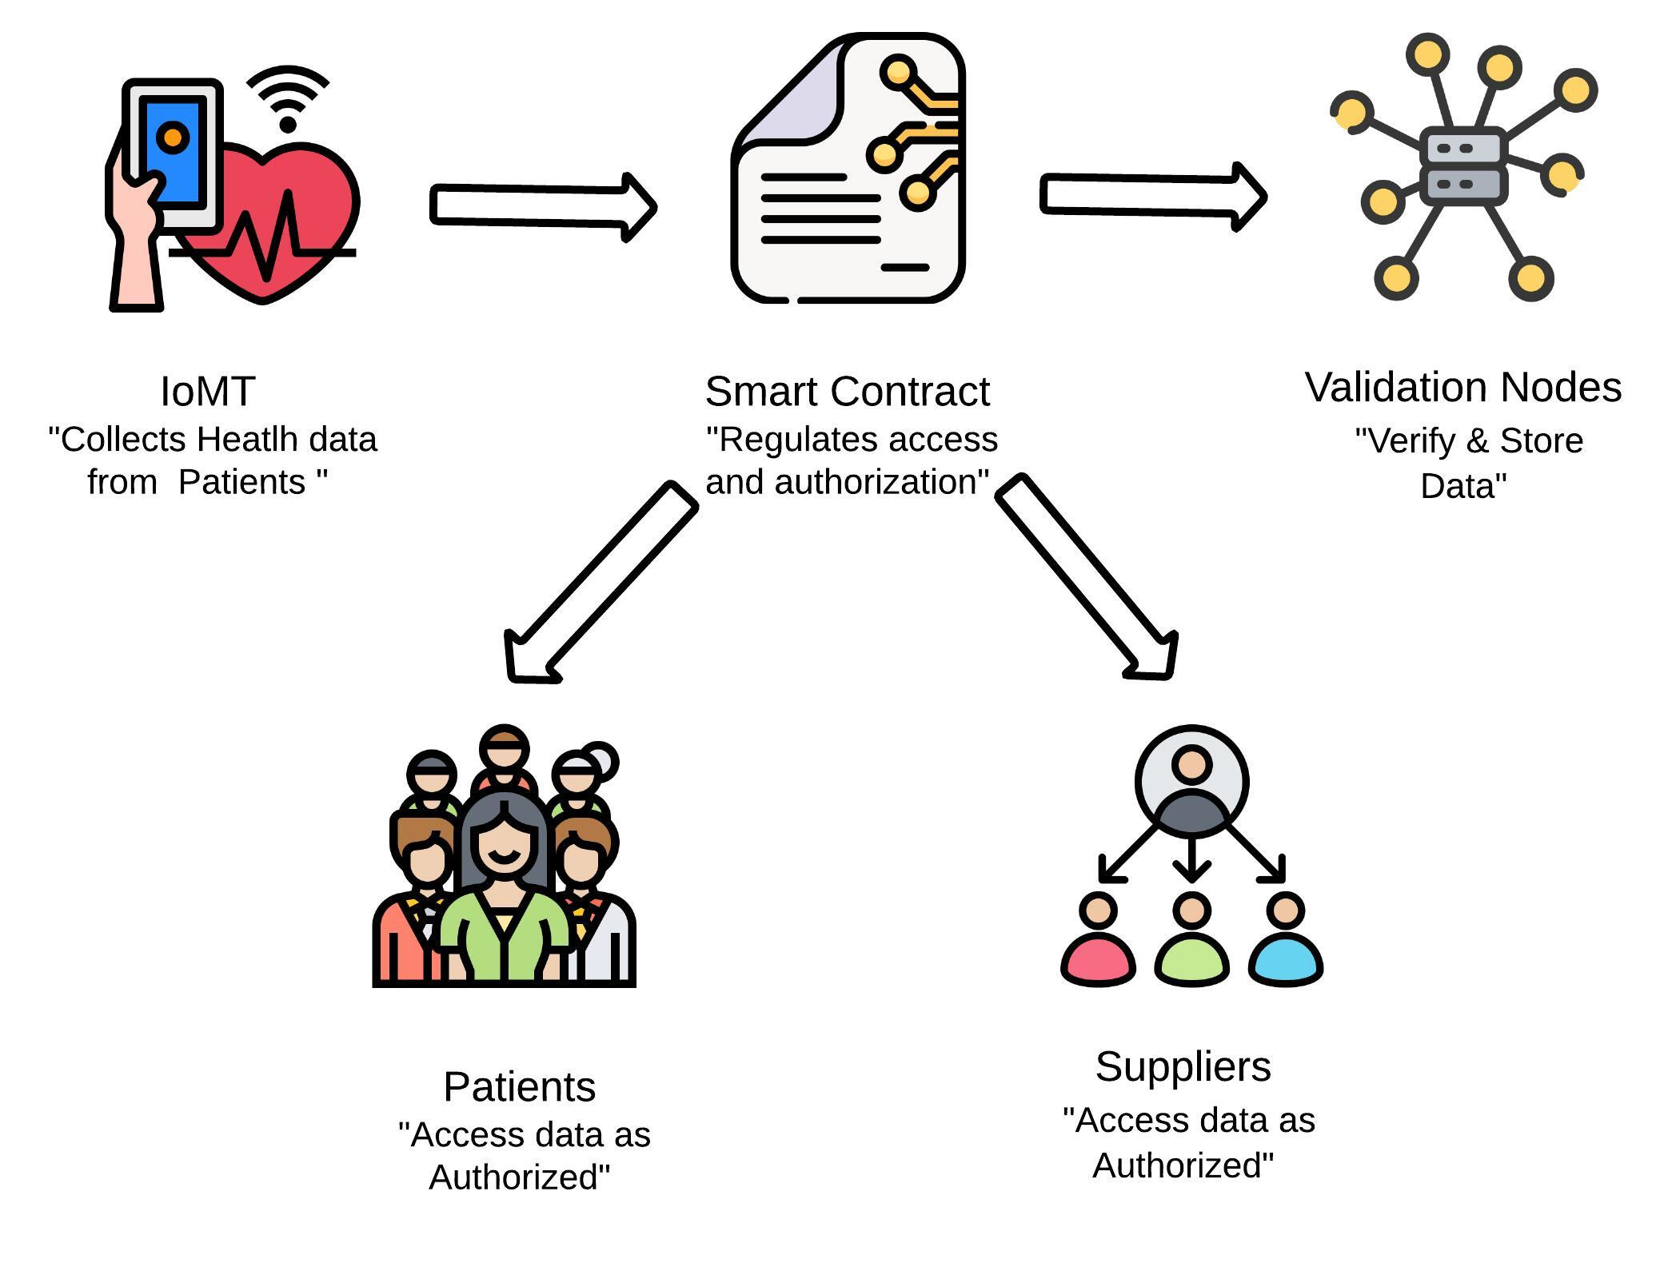







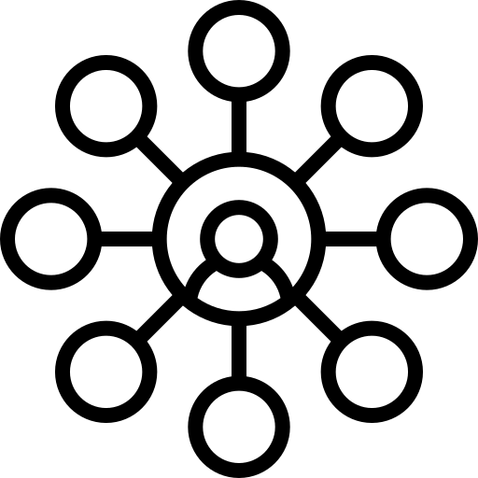
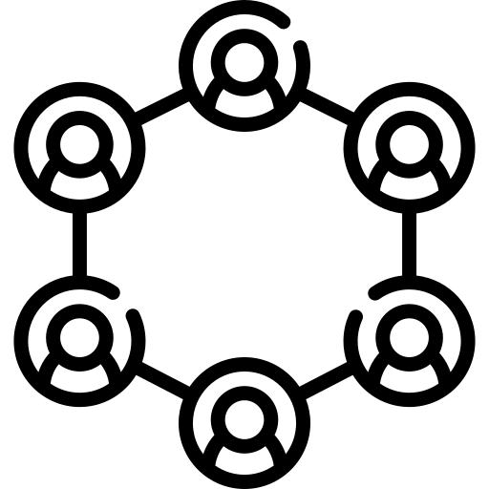

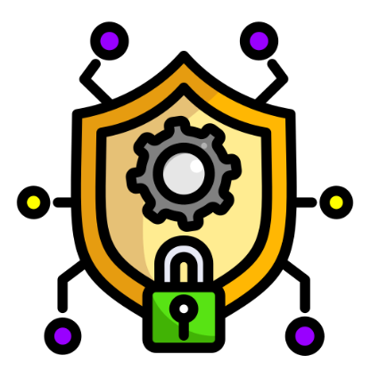
Blockchain in Healthcare Data Management
Ana Clara R. Quilapan – 2022475
Proposal for a Secure and Decentralised System for Medical Information Management
GitHub:https://github.com/2022475/HealthDataManagement-DApp.git
Abstract
Conceptual Frameworks
Success Examples:
Estonia: Since 2012, successfully implemented blockchain to protect health data securely and efficiently.
European Parliament: In 2020, a draft Resolution was introduced to promote the use of distributed ledger technologies, including blockchain, to enable citizens to protect and own their health data. (European Parliament, 2020).
Guard Health: A blockchain-based system ensuring privacy through a blockchain consortium.
The healthcare sector faces significant challenges in data security and privacy, as seen in the 2021 cyberattack on Ireland’s Health Service (HSE). Blockchain offers a solution with its decentralised, immutable infrastructure, enhancing data security, privacy, and patient control. This project proposes a blockchain-based approach for managing healthcare data, providing a secure, transparent system where only authorized parties have access.
Blockchain in Healthcare: Blockchain is a distributed and immutable database that enables the secure management of critical information (Blockchain in Healthcare, 2024). In the healthcare sector, blockchain offers: * Data Integrity: Once recorded, data cannot be modified or deleted (Case Study: Blockchain in Healthcare, 2024). * Privacy and Patient Control: Patients have control over who can access their information through smart contracts (Medinaceli, 2024). * Interoperability: Facilitates the secure exchange of data among different healthcare entities (Blockchain in Healthcare, 2024).
Conclusion
Findings
Blockchain technology provides a powerful solution to the security and privacy issues in healthcare data management. By leveraging its decentralized, transparent infrastructure, we can reduce vulnerabilities like those seen in the 2021 HSE cyberattack. This project empowers patients by giving them full control over their data and ensures only authorized parties have access. Moving forward, blockchain adoption can lead to a safer, patient-centric healthcare ecosystem.
What Blockchain is?
Identified Benefits:
Improved Security: The decentralized infrastructure eliminates the risk of a single point of failure, as seen in the case of the HSE (Ireland Health Service Executive, 2021).
Transparency and Patient Control: Every interaction with the data is recorded on the blockchain, and smart contracts allow patients to decide who has access (Blockchain in Healthcare, 2024).
Attack Prevention: By distributing information across multiple nodes, it becomes extremely difficult for attackers to compromise the system (Case Study: Blockchain in Healthcare, 2024).
Methodology
Blockchain is a secure digital ledger that records transactions in a decentralized way. Instead of relying on a central authority, it is maintained by many computers across a network. Each transaction is verified by the network and added in a way that cannot be changed, making the system transparent and highly secure.
System Components:
IoMT (Internet of Medical Things): Smart devices that monitor patients and send data to the blockchain, ensuring that it is accessible only to authorized parties (Case Study: Blockchain in Healthcare, 2024).
Smart Contracts: Automate access authorization and ensure that only authorized parties can view the information (Medinaceli, 2024).
Validation Nodes: Blockchain nodes play a key role by storing copies of the entire blockchain and participating in transaction validation through a consensus mechanism. This process ensures that only legitimate transactions are added to the blockchain, preventing manipulation attempts (Lecture 1 - Introduction to Blockchain Technology, 2022).
References
- Medinaceli, K., 2024. Blockchain en la gestión de datos médicos. XVII Encuentro de Seguridad en Salud. [Online] Available at: [URL if applicable]. - Blockchain is a digital ledger that stores a list of transactions (Lecture 1 - Introduction to Blockchain Technology, 2022). - Blockchain in Healthcare, 2024. Report on integrating blockchain technology in health data management. [Online] Available at: [URL if applicable]. - Case Study: Blockchain in Healthcare, 2024. Comprehensive analysis on blockchain technology for IoMT security. [Online] Available at: [URL if applicable]. - Ireland Health Service Executive (HSE), 2021. Ransomware Attack on HSE: Causes and Consequences. [Online] Available at: [URL if applicable].
Centralised
Decentralised

